Slide 1
Automated spatiotemporal annotation of sound objects in a scene
COMP.SGN.250 Signal Processing Innovation Project
Final Presentation
Einari VAARAS
Kalle LAHTINEN
Mehmet AYDIN

Slide 2
Introduction
Audio streams, such as broadcast news, documentaries and personal videos contain sounds from a wide variety of sound sources
These streams include detectable audio events of interest, such as speech, music or sounds of animals
Beside the detection of sound event presence there is a need for detecting the direction of arrival (DOA) of the detected sound event. For such cases Deep Learning methods are often used but requires annotated data which is laborious and difficult to do reliably
The aim is to explore the possibility of automatically annotating spatial and temporal dimensions of sound objects detected in an audio stream with the help of a 360-degree

Slide 3
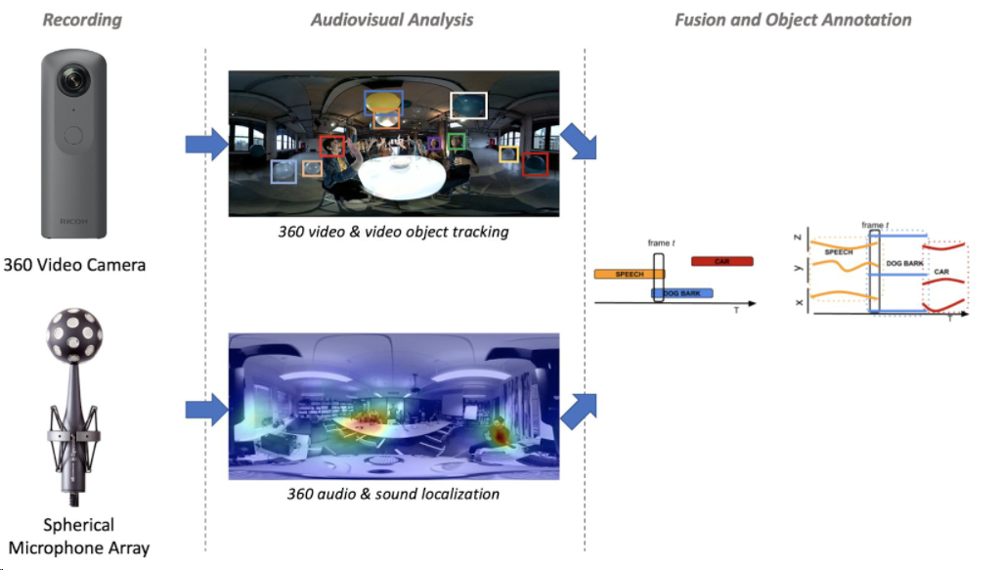

Slide 4
Project Steps
Studying object detection methods for 360-degree video data
Determining and defining the scenes to be recorded
Recording spatiotemporal scenes with a 360-degree camera and integrated 360-degree microphone
Applying object detection to the video recording
Extracting temporal object detections and their locations from the video recording
Formulating spatiotemporal labels for the audio data by combining video and audio detections

Slide 5
Technologies
Ricoh Theta V 360 camera and TA-1 3D microphone module
Microphone array of 4 microphones
YOLO (You Only Look Once) version 4 video detection network applied on 360 equirectangular video frames
Method based on paper by Wenyan Yang, Yanlin Qian, Francesco Cricri, Lixin Fan, Joni-Kristian Kamarainen
Open source github project found to use as a basis
B-format audio decoding, powermap calculation and beamforming scripts provided by Archontis Politis

Slide 6
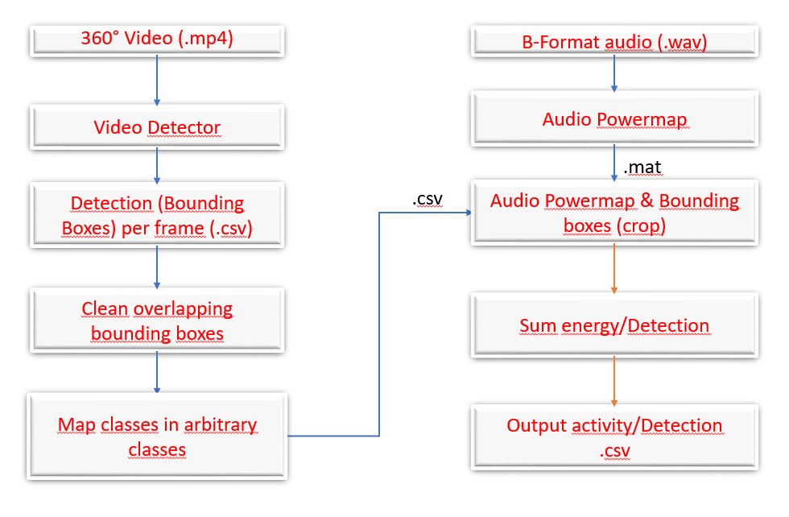
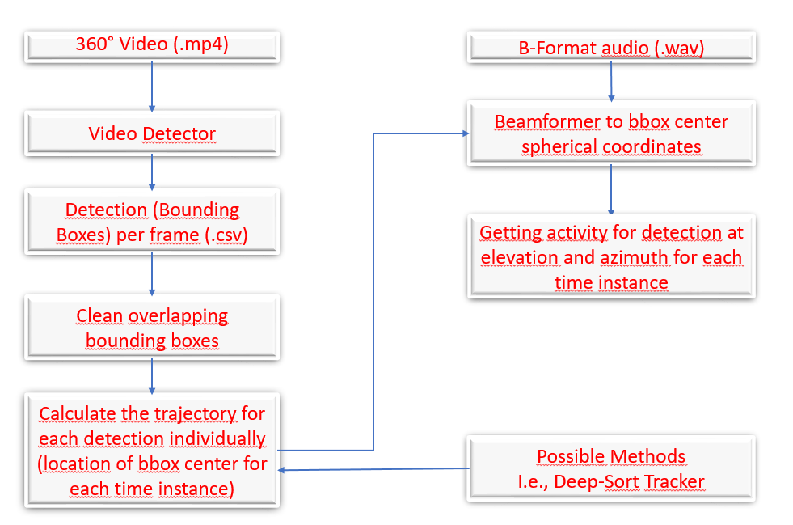
Implemented Pipelines
Pipeline version 1
Pipeline version 2

Slide 7
Pipeline version 1

Slide 8
Video Detector and Detection Output
YOLO video detection network
Equirectangular video frames projected to 4 sub image planes, which is fed to the detector
So 4 YOLO detections per 360 frame
Mp-YOLO –project (by Tsung-Shan, Yang) provided the projection implementation
We complemented the code to process video files, fixed a minor bug and added the functionality to output detections to a csv-file
Detections in sub images -> Detection coordinates transformed back to equirectangular frame coordinates

Slide 9
Detection Output
Detections outputted to csv-file (frame id, class id, label, confidence, bounding box center coordinates, bounding box size)
All this is done offline, i.e. no hard time requirements for processing time

Slide 10
Demo video 1
(video with cell phone)

Slide 11
Demo video 2
(video with sink)

Slide 12
Demo video 3
(video with keyboard)

Slide 13
Clean overlapping bounding boxes
Basic idea of algorithm:
If there are same classes present in the same video frame:
If there are overlapping bounding boxes (determined by IoU):
If overlap exceeds a predetermined threshold:
Remove bounding box with least confidence

Slide 14
Demo of cleaning overlapping bounding boxes (initial video)
(video with the three of us talking, no cleaning for bounding boxes)

Slide 15
Demo of cleaning overlapping bounding boxes (cleaned bounding boxes)
(same video as in previous slide, cleaned bounding boxes)

Slide 16
Class mapping function
It is possible to change the class indeces and names of classes into arbitrary classes

Slide 17
Demo of mapping classes
(video with the three of us talking with an arbitrary mapping of classes)

Slide 18
Audio powermap
A function made by Archontis converts the B-format audio into a powermap
MUSIC (MUltiple SIgnal Classification) algorithm used

Slide 19
Demo of audio powermap
(video of audio powermap without any cropping)

Slide 20
Crop powermap using bounding boxes
The detectected bounding boxes in the frame are used to crop the powermap array
Values within the bounding box are left unchanged, everything else is set to zero

Slide 21
Demo of cropped powermap
(video of audio powermap with cropping)

Slide 22
Determine energy based on cropped powermap
The values of the cropped powermap arrays are summed together
If the total audio energy in the bounding box exceeds a set threshold the audio activity for that class is set to one, otherwise zero
The new detections (with audio activity information and detection location in spherical coordinates) are outputted to a csv-file

Slide 23
Output example
(a screenshot of output CSV file)

Slide 24
Pipeline version 2

Slide 25
Beamforming
Beamforming can also be used to determine audio activity (function by Archontis)
”Listens” to a pointed direction
How to get a pointed direction?
Multi-frame (video) audio segments
Frame-level (video) audio segments
DeepSORT

Slide 26
Multi-frame (video) audio segments
We want to find the temporal trajectories of visual objects (from the video tracker)
Problem: how to find correspondences between objects in consecutive frames?
Have only one object present in video (current implementation)
Some more advanced method, e.g. a video object tracker
Handle everything on frame-level (also implemented)

Slide 27
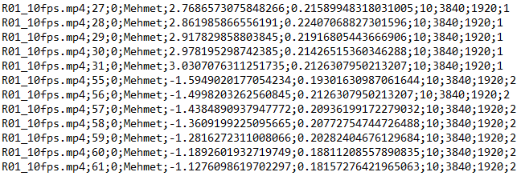
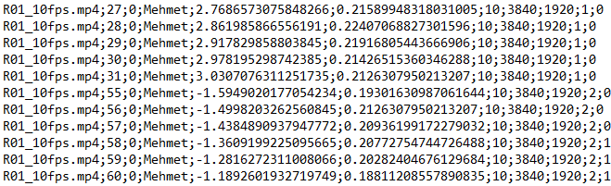
Demo of only one object present in video

Slide 28
Frame-level (video) audio segments
Basic idea:
For each frame:
Take the 100-ms audio segment corresponding to the video frame (video at 10 fps)
List all detected objects within the frame
For each object in a frame, give the bounding box center coordinates (azimuth, elevation) to the beamformer

Slide 29
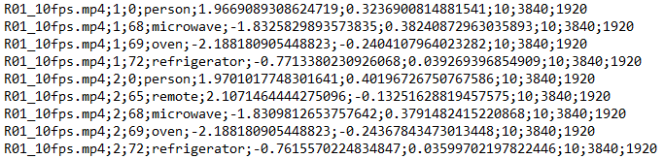
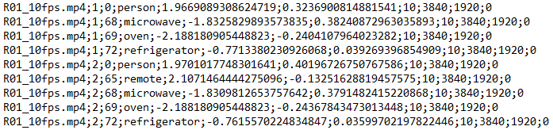
Demo of frame-level audio segments

Slide 30
Future Development Targets

Slide 31
Future Development
The project worked as a proof-of-concept
The system should be tested more vigorously
More recordings, testing the produced data in actual training
Trying out the system with a microphone array with a better spatial resolution
Making the pipeline end-to-end
Adding more intelligent object tracking methods for producing accurate object trajectories within longer time windows (DeepSORT!)

Slide 32
DeepSORT
DeepSort is a traditional single-hypothesis multi-target tracking method using recursive Kalman filtering and frame-by-frame data correlation.
DeepSort adopts the fusion metric that combining the distance of predicted position and the observed position in the Markov space and the cosine distance of the apparent feature between the bounding boxes in the Kalman filter.

Slide 33
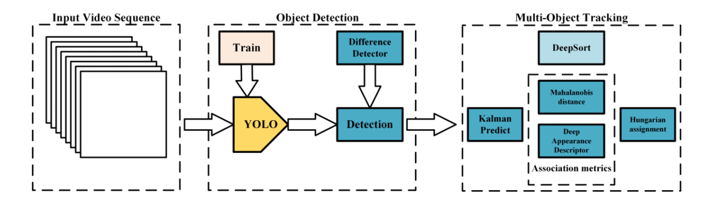
DeepSORT- Workflow
Figure : The workflow of real-time detection and tracking [1]

Slide 34
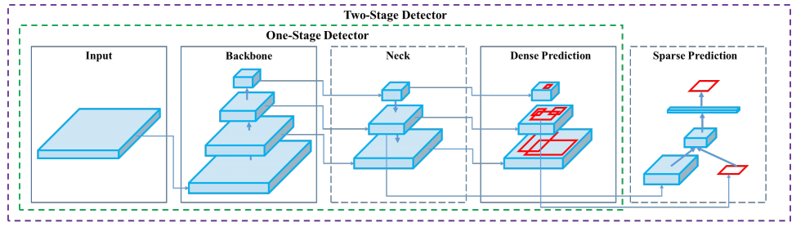
DeepSORT – Object Detection
Figure : Architecture of object detection of YOLOv4 [2]
Input: {image, patches, image pyramid}
Backbone: {VGG16, ResNet50, ResNeXt-101, Darknet53}
Neck:
Head:
Dense Prediction: {RPN, YOLO, SSD, Retina-Net, FCOS}
Sparse Prediction: {Faster R-CNN, R-FCN} [2]

Slide 35
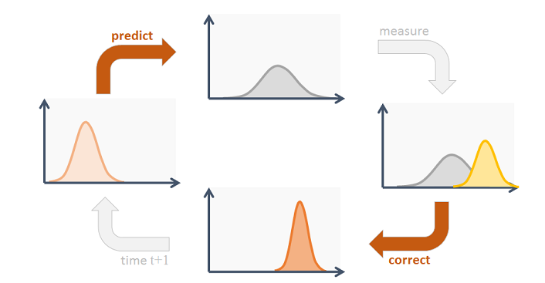
DeepSORT – Kalman Filter
Source:https://www.codeproject.com/Articles/865935/Object-Tracking-Kalman-Filter-with-Ease

Slide 36
Successes and Challenges
Overall the project proceeded quite steadily, no bigger obstacles all spring
At the very end we noticed that there was no licensing defined for the mp-YOLO github project we had used as a basis for the video detection part
Contacted the developer and got a license file added! Phew.

Slide 37
References
[1] Xu Zhang, Xiangyang Hao, Songlin Liu, Junqiang Wang, Jiwei Xu, Jun Hu, "Multi-target tracking of surveillance video with differential YOLO and DeepSort," Proc. SPIE 11179, Eleventh International Conference on Digital Image Processing (ICDIP 2019), 111792L (14 August 2019); doi: 10.1117/12.2540269
[2] Alexey Bochkovskiy,Chien-Yao Wang,Hong-Yuan Mark Liao, "YOLOv4: Optimal Speed and Accuracy of Object Detection ", 2020
[3] Wenyan Yang, Yanlin Qian, Francesco Cricri, Lixin Fan, Joni-Kristian Kamarainen, “Object Detection in Equirectangular Panorama”, 2018
[4] Tsung-Shan, Yang, mp-YOLO, https://github.com/keevin60907/mp-YOLO

